Slide 1

MFC5J3 Development Information
August. 02. 2021
Chassis & Safety | Advanced Driver Assistance Systems

Slide 2
Agenda
1
MFC5J3 Solution Overview
2
System Architecture
3
Project Development Plan
4
HW/SW development status
5
CEM Available Component
6
Problem to be solved

Slide 3
MFC5J3 Solution Overview
MFC5J3 is a front viewing automotive monocular camera system
MFC5J3 configures ADAS functions and will particularly support the fulfillment of the CNCAP and Euro NCAP
Base on MFC5J3, 1R1V and 3R1V system is under development:
1R1V – MFC5J3 + LRR ARS5xx
3R1V – MFC5J3 + LRR ARS5xx + 2 x SRR5xx (front L/R)
Function bundles processed inside MFC5J3 are listed below:
ACC, AEB, TJA, LDW, LKA, LDP, RDP, TSA, HLA.

Slide 4
MFC5J3 Solution Overview
Subcomponent Communication Topology
1R1V – MFC5J3 + LRR ARS5xx
3R1V – MFC5J3 + LRR ARS5xx + 2 x SRR5xx (front L/R)
1R1V
3R1V

Slide 5
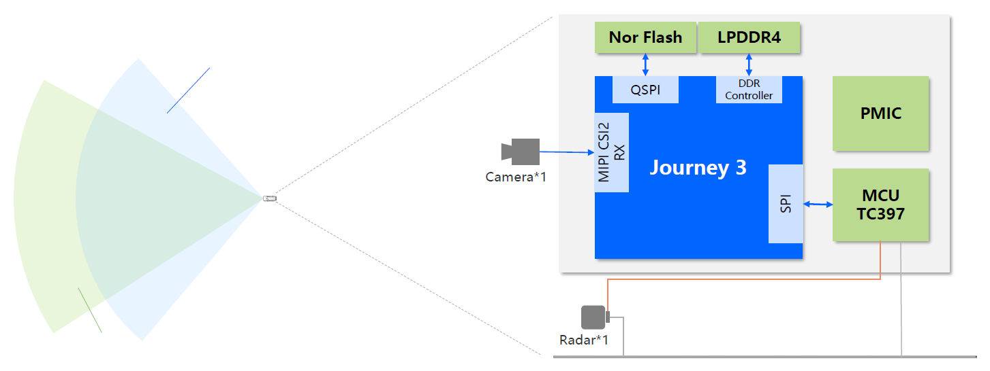
MFC5J3 Solution Overview
1R1V – MFC5J3 + LRR ARS5xx
Front Monocular Camera
1.7MP @ 30FPS
FOV 110°
TC387
Private CAN
ARS5xx
Public CAN

Slide 6
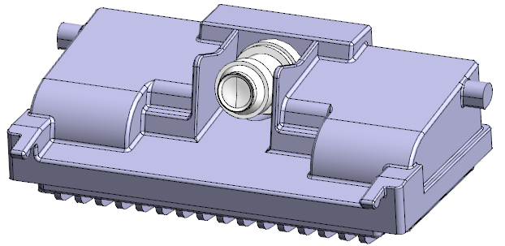
MFC5J3 Technical Overview
CEM
Driving
Function
ACC
AEB
LCF
Perception
Basic Software
HLA
TSR
Horizon J3
Aurix TC387
Horizon
Continental
1R1V Solution

Slide 7


MFC5J3 Project timing (1R1V)
2021
2022
MFC5J3
Jul
Aug
Sep
Oct
Nov
Dec
Jan
Feb
Mar
Apr
May
Jun
HW
A Sample
Pre DV
B Sample
DV
PV
BSW
BSW development
BSW dev.
BSW Bug fix
1st SW Integration
Full Function SW
SW final release
CEM&DF
Function Development
Function development+bug fix
Full Function
Performance tuning and bug fix
Perception
Perception SW Development
Perception SW Development+bug fix
Perception SW tuning+bug fix
Production
Industrialization
build
Components sourcing
PPAP
EMS
PSW
SOP
08/02/2021

Slide 8
MFC5J3 1R1V HW development status
Schematic – Design on going by Conti
Plan to release schematic mid Aug.
Time duration: middle July to middle August.
PCB - on sourcing
PCB design, simulation, manufacture vendor is on sourcing.
Time plan: Gerber release at middle of September, time pressed.
Camera module - on sourcing
Eight 8M optical modules from Foxcom have been received.

Slide 9
MFC5J3 1R1V SW development status
TC387 EB Autosar stack purchase in process
Questionnaire submitted, wait for quote.
Consider use temporary Autosar stack for advanced development with G-Pulse.
Role & Response
[TC387]Driving function by Conti: RTE interface first version complete.
[J3]Fusion function by Conti: J3 development strategy under discussion with Horizon.
[TC387]SPI Interface by G-Pulse: Interface under discussion with Horizon.
[TC387]MTS by Conti: Strategy confirmed, to be implemented.

Slide 10
MFC5J3 DF SW development Strategy
In order to accomplish the full function SW of 1R1V solution milestone in Q1 2022, it is decided to take CEM + ACC Gen4 as current longitudinal function architecture:
Radar ECU
Function ECU
Illumination and Preprocessing
Signal Processing
Environmental Model
Object Selection
Gen4 ACC Functions
Object Selection
F
Raw Data
Cluster List
Object List
40 Relevant Objects
MFC5J3
Function ECU
Illumination and Preprocessing
Signal Processing
CEM
Object List ??
22 Relevant Objects ??
Road/Lane info ??
Gen4 ACC Functions
F
Raw Data
Cluster List
F
- Fusion

Slide 11
MFC5J3 CEM Component
Component | Available for ACC Gen4?
SEF Static Environment | No
EML Ego Motion & Localization | No
TPF Traffic Participants | Yes
RMF Road Modle | TBD
FSF Freespace | No
PCL Parking & Curb Lines | No
TCI Traffic Control Information | No
COH Coherence & Scene Detection | No

Slide 12
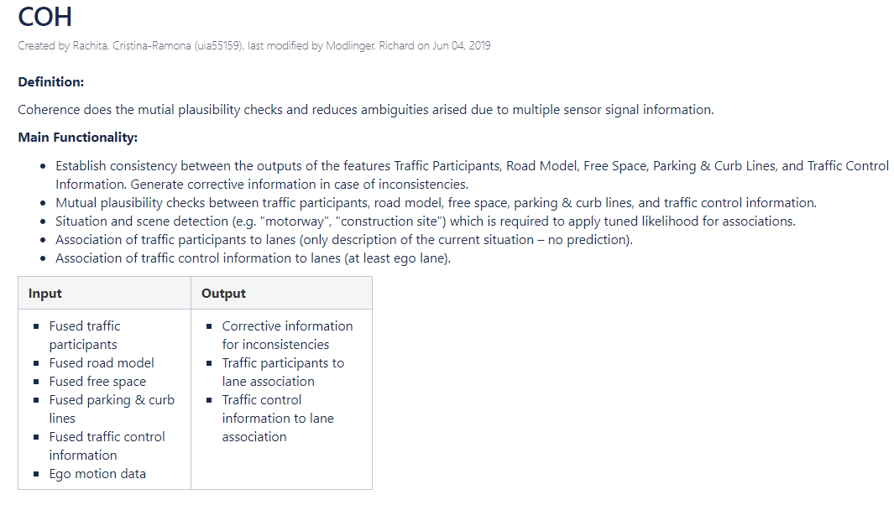
COH Component Functionality

Slide 13
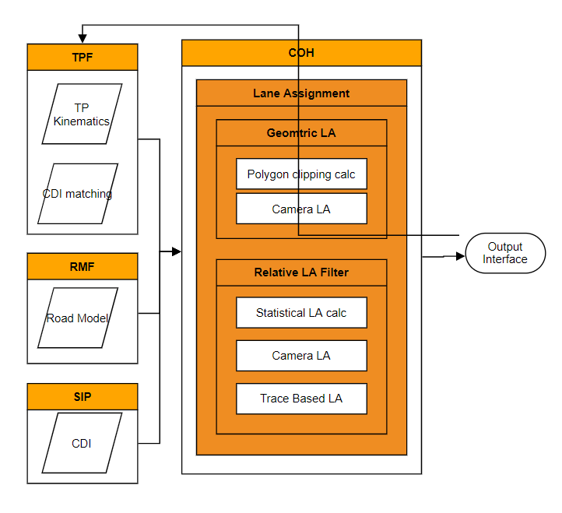
Lane Assignment Sub-component Functionality
Lane Assignment
Determine which traffic participant (TP) is driving on which lane
Calculation depends heavily on the output of TPF and RMF components, and as well the camera data

Slide 14
Problem to be solved
No. | Problem | Solution | Comment & Attachment
1 | Solution to be decide: TPF only -> Object List TPF + RMF + COH -> Object List w/ Lane Info | Have to use Solution a
2 | TPF only: If TPF output interface enough for ACC Gen4?
3 | TPF only: How to handle with missing interface? | Receive from Radar/Camera non fused output: e.g. Radar OD/LD, Camera Lane info
4 | TPF only: Does RMF module missing affect Cut-in Cut-out performance? | It is mandatory to have RMF module. Hard to ensure KPI without Lane & Road boundry information.
5 | Possibility of code management in Github? | Import ACC Gen4 algo into Github
6
7
8

Slide 15
Thank you
For your attention!

